Slide 1
Matplotlib and Seaborn modules

Slide 2
What is MATPLOTLIB?
Matplotlib is a data visualization library used for 2D graphics in python programming language. It can be used in python scripts, shell, web application servers and other graphical user interface toolkits.
Before we start using this library, we need to install this library into our system by typing the below commands into our systems.
Importing the library
To get matplotlib up and running in our environment, we need to import it.
pip install matplotlib
import matplotlib.pyplot as plt

Slide 3
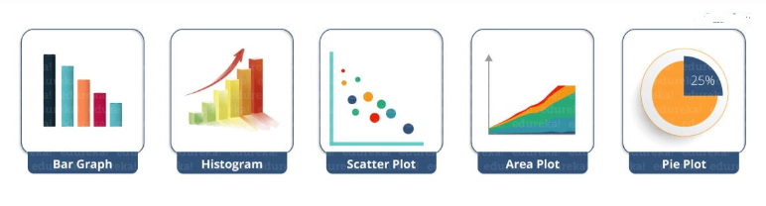
Python Matplotlib : Types of Plots
There are various plots which can be created using python matplotlib. Some of them are listed below:

Slide 4
Types of Plot
Before we start with the types of plot, let us see very basic codes in python matplotlib in order to generate a simple graph.
from matplotlib import pyplot as plt
from matplotlib import pyplot as plt
#Plotting to our canvas
plt.plot([1,2,3],[4,5,1])
#Showing what we plotted
plt.show()

Slide 5
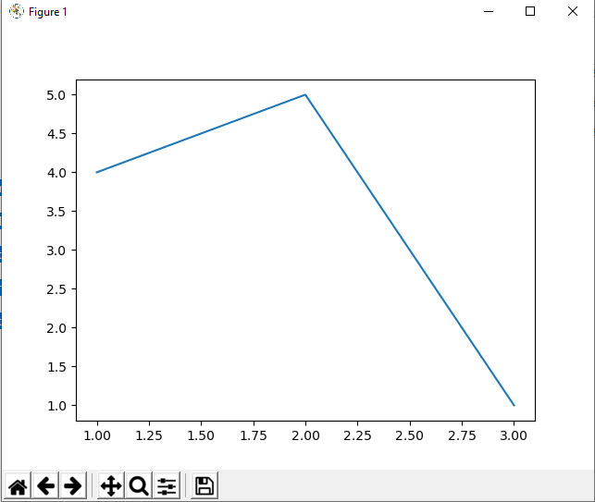

Slide 6
Let us see how can we add title, labels to our graph created by python matplotlib library to bring in more meaning to it. Consider the below example: from matplotlib import pyplot as plt x = [5,2,7] y = [2,16,4] plt.plot(x,y) plt.title('Info') plt.ylabel('Y axis') plt.xlabel('X axis') plt.show()

Slide 7
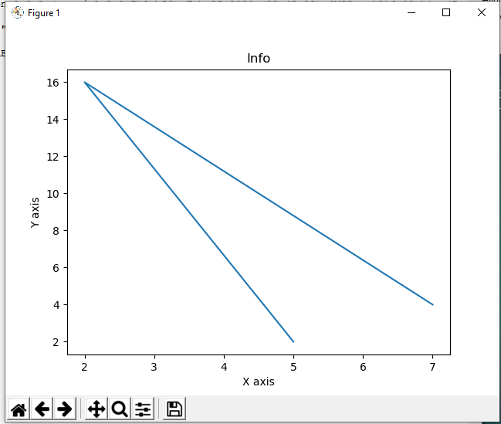

Slide 8
Python Matplotlib: Bar Graph
A bar graph uses bars to compare data among different categories. It is well suited when you want to measure the changes over a period of time. It can be represented horizontally or vertically. Also, the important thing to keep in mind is that longer the bar, greater is the value. Now, let us practically implement it using python matplotlib.
from matplotlib import pyplot as plt
plt.bar([0.25,1.25,2.25,3.25,4.25],[50,40,70,80,20],
label="BMW",width=.5)
plt.bar([.75,1.75,2.75,3.75,4.75],[80,20,20,50,60],
label="Audi", color='r',width=.5)
plt.legend()
plt.xlabel('Days')
plt.ylabel('Distance (kms)')
plt.title('Information')
plt.show()

Slide 9
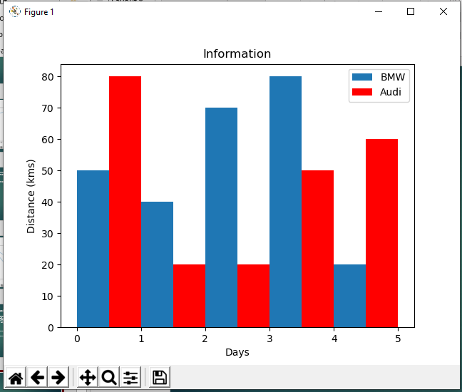

Slide 10
Python Matplotlib – Histogram
Histograms are useful when you have arrays or a very long list. Let’s consider an example where I have to plot the age of population with respect to bin. Now, bin refers to the range of values that are divided into series of intervals. Bins are usually created of the same size. In the below code, I have created the bins in the interval of 10 which means the first bin contains elements from 0 to 9, then 10 to 19 and so on.
EX:
import matplotlib.pyplot as plt
population_age = [22,55,62,45,21,22,34,42,42,4,2,102,95,85,55,110,120,70,65,55,111,115,80,75,65,54,44,43,42,48]
bins = [0,10,20,30,40,50,60,70,80,90,100]
plt.hist(population_age, bins, histtype='bar', rwidth=0.8)
plt.xlabel('age groups')
plt.ylabel('Number of people')
plt.title('Histogram')
plt.show()

Slide 11
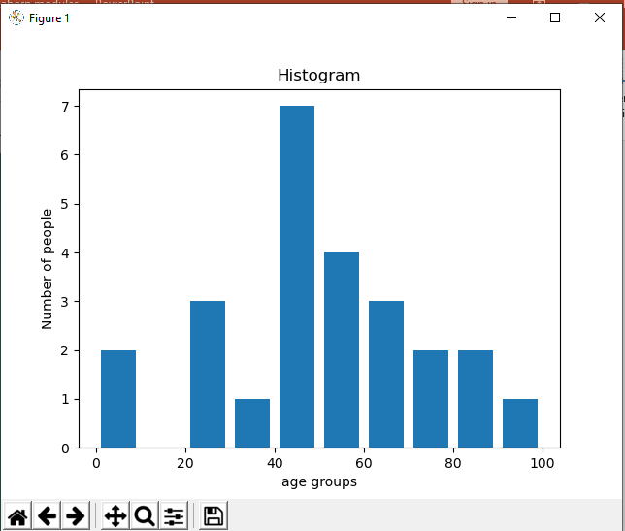

Slide 12
Python Matplotlib : Scatter Plot
Usually we need scatter plots in order to compare variables, for example, how much one variable is affected by another variable to build a relation out of it. The data is displayed as a collection of points, each having the value of one variable which determines the position on the horizontal axis and the value of other variable determines the position on the vertical axis.
Ex:
import matplotlib.pyplot as plt
x = [1,1.5,2,2.5,3,3.5,3.6]
y = [7.5,8,8.5,9,9.5,10,10.5]
x1=[8,8.5,9,9.5,10,10.5,11]
y1=[3,3.5,3.7,4,4.5,5,5.2]
plt.scatter(x,y, label='high income low saving',color='r')
plt.scatter(x1,y1,label='low income high savings',color='b')
plt.xlabel('saving*100')
plt.ylabel('income*1000')
plt.title('Scatter Plot')
plt.legend()
plt.show()

Slide 13
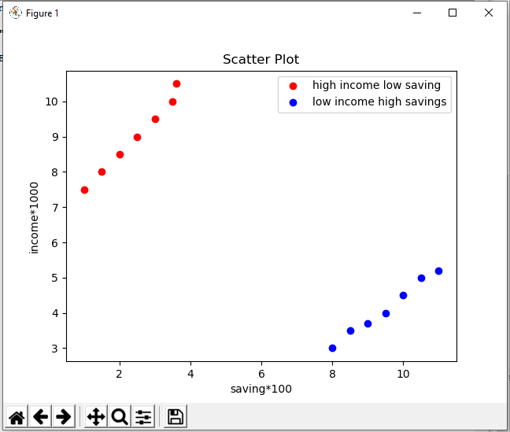
As you can see in the above graph, I have plotted two scatter plots based on the inputs specified in the above code. The data is displayed as a collection of points having ‘high income low salary’ and ‘low income high salary’.

Slide 14
Python Matplotlib : Area Plot
Area plots are pretty much similar to the line plot. They are also known as stack plots. These plots can be used to track changes over time for two or more related groups that make up one whole category. For example, let’s compile the work done during a day into categories, say sleeping, eating, working and playing. Consider the below code:
import matplotlib.pyplot as plt
days = [1,2,3,4,5]
sleeping =[7,8,6,11,7]
eating = [2,3,4,3,2]
working =[7,8,7,2,2]
playing = [8,5,7,8,13]
plt.plot([],[],color='m', label='Sleeping', linewidth=5)
plt.plot([],[],color='c', label='Eating', linewidth=5)
plt.plot([],[],color='r', label='Working', linewidth=5)
plt.plot([],[],color='k', label='Playing', linewidth=5)
plt.stackplot(days, sleeping,eating,working,playing, colors=['m','c','r','k'])
plt.xlabel('x')
plt.ylabel('y')
plt.title('Stack Plot')
plt.legend()
plt.show()

Slide 15
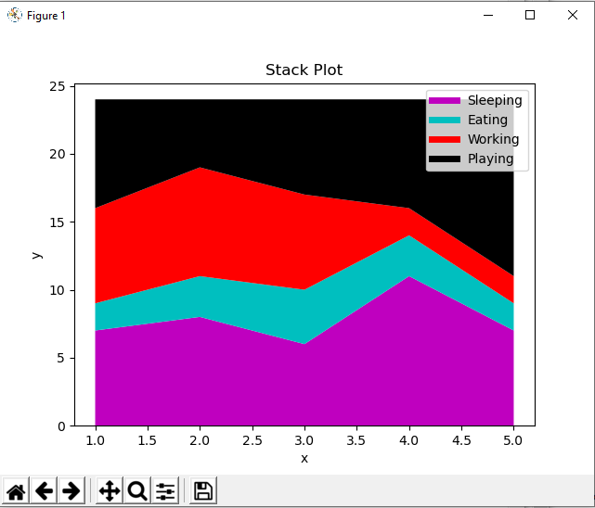
As we can see in the above image, we have time spent based on the categories. Therefore, area plot or stack plot is used to show trends over time, among different attributes. Next, let us move to our last yet most frequently used plot – Pie chart.

Slide 16
Python Matplotlib : Pie Chart
A pie chart refers to a circular graph which is broken down into segments i.e. slices of pie. It is basically used to show the percentage or proportional data where each slice of pie represents a category. Let’s have a look at the below example:
import matplotlib.pyplot as plt
days = [1,2,3,4,5]
sleeping =[7,8,6,11,7]
eating = [2,3,4,3,2]
working =[7,8,7,2,2]
playing = [8,5,7,8,13]
slices = [7,2,2,13]
activities = ['sleeping','eating','working','playing']
cols = ['c','m','r','b']
plt.pie(slices,
labels=activities,
colors=cols,
startangle=90,
shadow= True,
explode=(0,0.1,0,0),
autopct='%1.1f%%')
plt.title('Pie Plot')
plt.show()

Slide 17
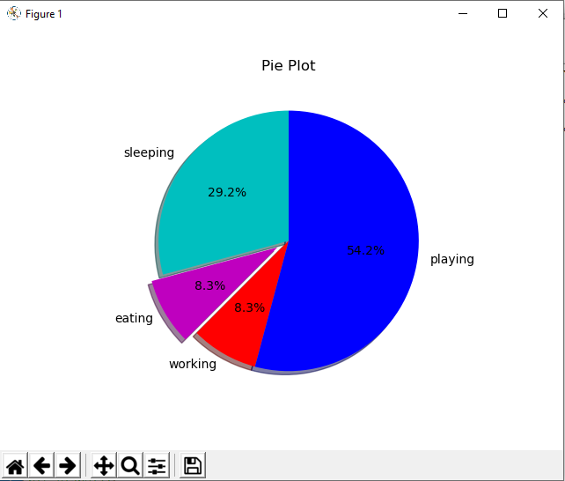
In the above pie chart, I have divided the circle into 4 sectors or slices which represents the respective category (playing, sleeping, eating and working) along with the percentage they hold. Now, if you have noticed these slices arts are really useful as you don’t have to be the one who calculates the percentage or the sadds up to 24 hrs, but the calculation of pie slices is done automatically for you. In this way, pie chlice of the pie.

Slide 18
Few Important Functions
If you are using Matplotlib from within a script, the function plt.show() is your friend. plt.show() starts an event loop, looks for all currently active figure objects, and opens one or more interactive windows that display your figure or figures.
the plt.show() command should be used only once per Python session, and is most often seen at the very end of the script. Multiple show() commands can lead to unpredictable backend-dependent behavior, and should mostly be avoided.
plt.title() command is used to provide title to your plot.

Slide 19
References https://jakevdp.github.io/PythonDataScienceHandbook/04.00-introduction-to-matplotlib.html https://www.geeksforgeeks.org/python-introduction-matplotlib/ https://www.youtube.com/watch?v=zYdHr-LxsJ0 https://matplotlib.org/tutorials/introductory/pyplot.html

Slide 20
THANK YOU

